Slide 1
Discussion 1:
Intro to Java
Christine Zhou

Slide 2
Agenda
Introductions & About Me
Announcements
Git
Worksheet!

Slide 3
Introductions & About Me
Christine, 3rd year
Email: cazhou@berkeley.edu
Feel free to email me!
Always available to chat one-on-one
What is your name, year, major?

Slide 4
Announcements
Lab1 is due tonight at 11:59PM.
HW0 is due this Friday at 11:59PM.
Office hours and discussion/lab calendars on the course website.
Discussion survey: shoutkey.com/leak

Slide 5
Git
VCS (version-control system), can save your work and go back to previous versions very easily
You have a central repository living somewhere stored by git
You can use ‘git clone’ to get a copy of this central repository anywhere you want (ie. on your local computer and instructional account)
When you ‘git add X.java’, ‘git commit -m “...”’, and ‘git push’, you are sending your work to the central repository
Not to other copies of the repository!

Slide 6
Some Git Commands to Know
Camera analogy
git add: take a snapshot of your files (this is called staging your changes)
git commit: save the snapshot that you took with a message
git push: pushes snapshots from your repo to the central repo
git pull: pulls snapshots from the central repo to your repo
git status: shows the status of your repo
git log: shows all the snapshots/corresponding messages you’ve made on your repo
git tag: mark a specific snapshot with a tag

Slide 7
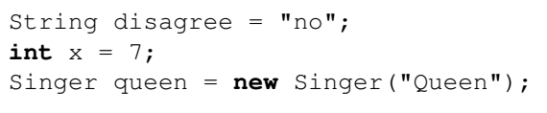
Javaian Rhapsody
Variable assignments, to different types (String, int, Singer)
String and int are provided in Java, Singer is a self-defined class!

Slide 8
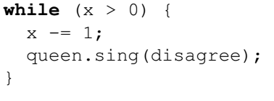
Javaian Rhapsody (continued)
While loops will continue as long as the condition is true
Condition in this case is x>0
Possible to loop infinitely if the condition is always true
Maybe we forget to decrement x?

Slide 9
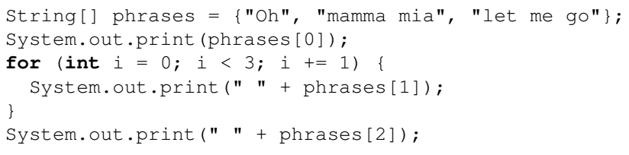
Javaian Rhapsody (continued)
Create arrays in Java with the bracket notation, can access with indexing
For loops: for (instantiation; condition; incrementation)
Will do what is within the brackets until the condition is false
System.out.print or System.out.println: how we print in Java!

Slide 10
2. Fibonacci
Remember: fib(N) = fib(N-1) + fib(N-2)
The 0-th fibonacci number is 0, the 1st is 1, etc.

Slide 11
2. Fibonacci (continued)
Too many redundant calculations when done recursively…
What other way can we approach this?

Slide 12
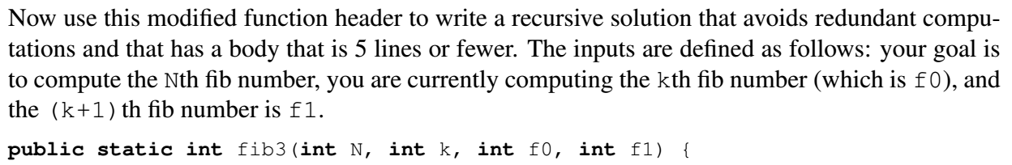
2. Fibonacci (continued)
Look at how we did the problem iteratively
Do the arguments of fib3 sound familiar to what we did in fib2?

Slide 13
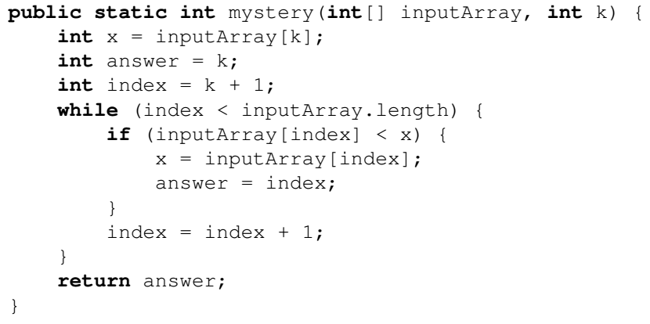
3. Mystery
Keep track of the variables when running through the example!
To determine what it’s doing, try to figure out what each of the variables stand for!

Slide 14
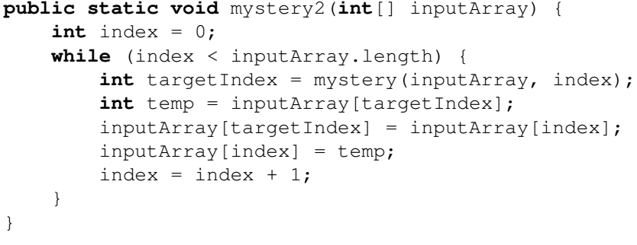
3. Mystery (continued)
Keep track of variables when running through an example?
What does targetIndex represent? (What does mystery do?)

